Slide 1
Revision Strategies
How can you help yourself

Slide 2
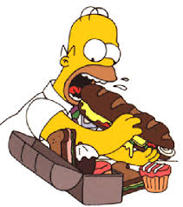
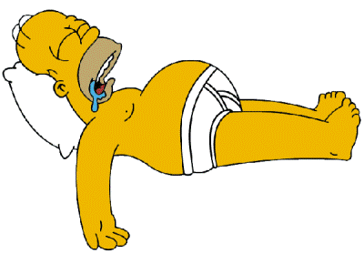
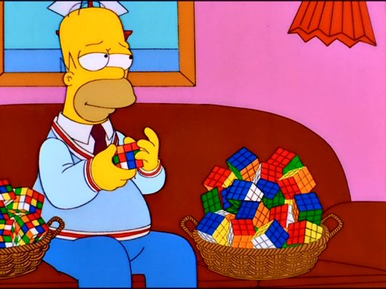
SLEEP
EAT
REVISE
EXERCISE
REPEAT

Slide 3
A survey of 12 year olds showed that 85% did not know what the term revision meant.
One pupil wrote: “it’s the word teachers use when they can’t think what to set you for homework.”

Slide 4
What is revision?
Check your understanding.
Make links between different topics to see how the whole subject fits together.
Remind yourself of material you have forgotten.
Reinforce your learning.
Identify and fill gaps in your knowledge.

Slide 5
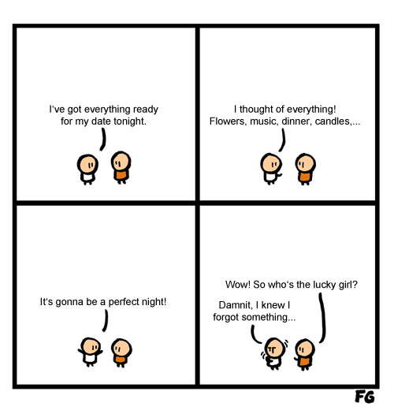
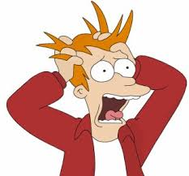
Notes:
Planning ahead – getting everything straight in your head and trying to avoid last minute panics
Hope to cope with stress and positively channel your nerves

Slide 7
3 elements
What different ways are there of revising? How can remember all that I need to know?
Doing all this and staying sane – how to de-stress!
Planning my revision – a practical start

Slide 8
Revision strategies

Slide 10
What different ways are there of revising?
How can remember all that I need to know?

Slide 11
20 tips for REVing up REVision
Use colour and pictures in your notes – this makes them more memorable.
Limit the time of your revision slots and build in rewards to keep you motivated. Try the Pomodoro Technique. There are five basic steps to the technique:
Decide on the task to be done
Set the pomodoro timer to a number of minutes (traditionally 25)
Work on the task until the timer rings
Take a short break (3-5 minutes)
Every four "pomodori" take a longer break (15–30 minutes)
Literacy skills are critical in ALL exams, not just English. Remember to check your spelling, punctuation and grammar.
Devise a chart, map, plan, grid which shows the key bits of knowledge and the key skills you will need to develop. Map where it fits with the big picture.
Create timelines of key dates and events
Use a traffic lights system on a full list of the syllabus to colour bits you feel very confident about (green), less so (yellow) and weak on (red).
Record notes out loud on your mp3 player and play back to you while in quiet time (on the bus etc)

Slide 12
20 tips for REVing up REVision
Be creative with different ways of explaining a concept:
Explain the concept to someone else out loud
Explain it in a spider diagram
Explain it in a flow chart
Explain it in a sequence of pictures
Put post-it notes and revision notes up around your bedroom to constantly absorb the information
Highlight key parts of text and then turn this into notes (writing things out helps then to stick in your memory)
Use mnemonics to remember lists or key facts/concepts
Create a poster of six pictures that summarise a topic – note key words around the picture
Create true/false cards and test yourself
Take an exam question and annotate it – showing what the key words
Do past paper questions, look at the mark schemes for what you have got correct and go over what you got wrong
Get other people to test you, repeat back to them your notes and the key facts
Time yourself answering exam questions – managing your time in some exams will be critical
Use websites where you can test yourself and review key concepts
Think about PEE in your notes: Point, Explain, Evidence (or Example)
TALK TO YOUR TEACHERS about what works for each subject.

Slide 13
Mind mapping

Slide 14
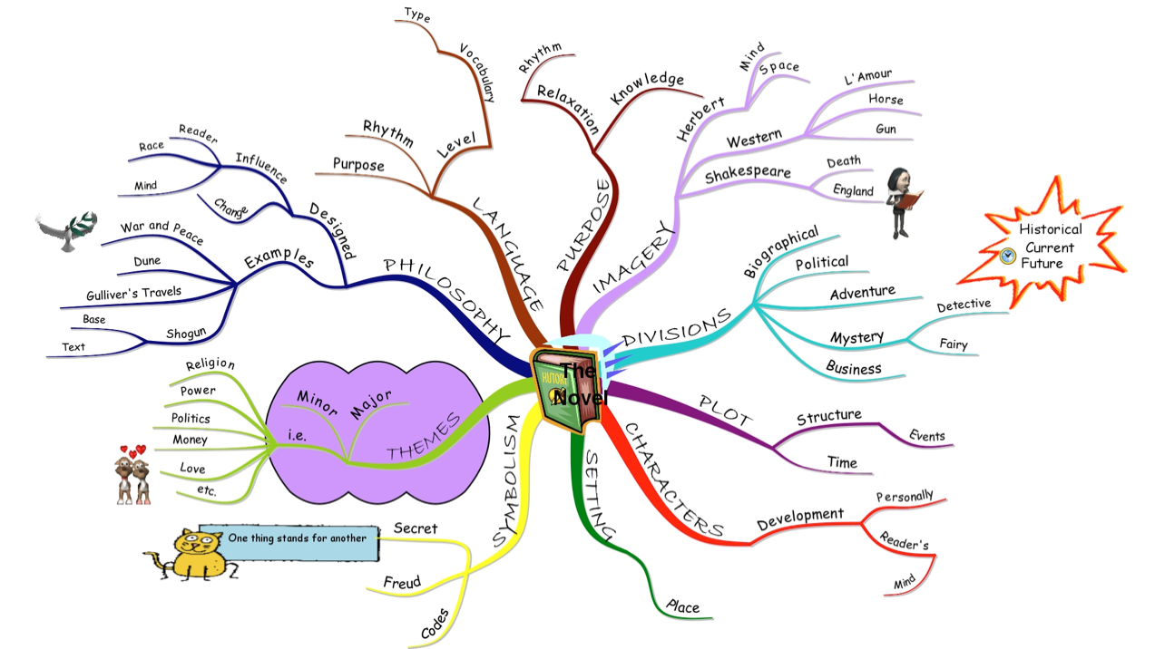

Slide 15
Key facts cards

Slide 16
Topic
Pythagoras’ Theorem
Right-angled triangles
a² + b² = c²
C is the hypoteneuse – the longest side
Example
Find x
a² + b² = c²
3² + 7² = c²
9 + 49 = c²
58 = c²
√58 = c Remember to √
7.62 = c (rounded to 2 significant figures – after the decimal point)
3
x
7

Slide 17
Point – Explain - Evidence

Slide 18
PEE
POINT
Feature – Meander – a large bend, especially in the middle or lower stages of a river course.
EXPLAIN
The results of lateral corrasion which becomes dominant over vertical corrasion as the gradient in the river decreases.
Erosion on the outer bank causes undercutting and river cliff. Slack water on inner bank causes deposition and a bank of sediment called a meander scroll is produced.

Slide 19
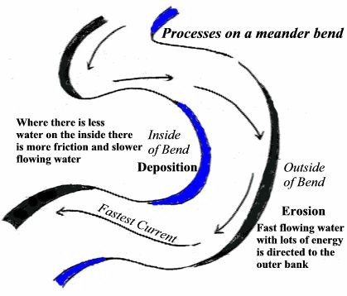
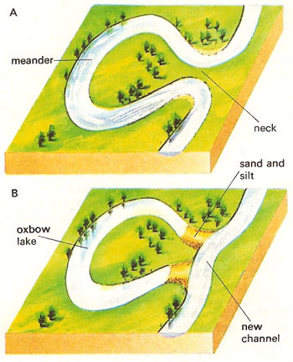

Slide 20
Mnemonics

Slide 21
Stage 1
Choose key words from a topic of your choice
Eg: Proteins (Food Tech)
Carbon
Hydrogen
Oxygen
Phosphors
Nitrogen
Stage 2
Use the first letter of each word to make a sentence or word that you can remember
Eg
Chops & N
(funny sentences are easier to remember)
➔

Slide 22
Using pictures

Slide 23
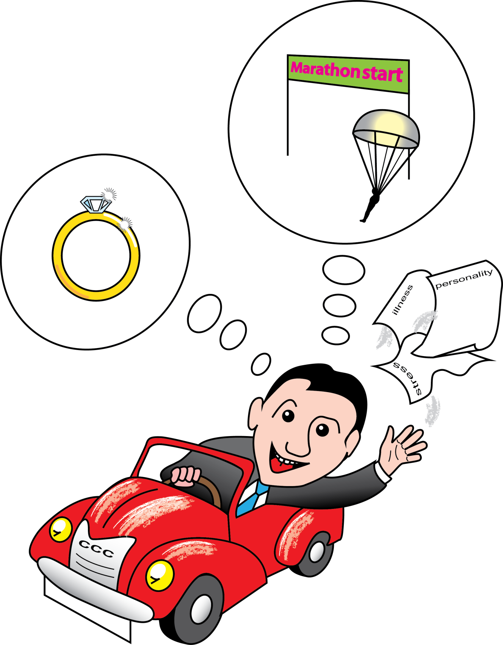

Slide 24
COMMITMENT
POINT: Hardy individuals show Commitment.
EXPLAIN: This means they are involved in what they do. They are committed to their work and personal relationships and have a strong sense of purpose.
EXAMPLE: For example, they may have many friends both inside and outside of work
CHALLENGE
POINT: Hardy individuals view potentially stressful situations as a challenge.
EXPLAIN: They see life changes as a challenge to be overcome, rather than a problem or threat.
EXAMPLE: For example, they may look forward to the challenges of a new job.
Hardy individuals show three Cs: Control, commitment, Challenge
Participants were asked to complete three questionnaires: a personality questionnaire; the SRRS over three years; a measure of their illness over three years
Kobasa interviewed 800 white, middle-class, male managers
CONTROL
POINT: Hardy individuals have a strong sense of personal control.
EXPLAIN: This means they feel that they are in control of their lives and can influence their situation, rather than being controlled by outside factors.
EXAMPLE: For example, they may not believe in fate or luck.
KOBASA 800

Slide 25
Staying Sane

Slide 26
Harnessing stress to motivate; Avoiding stress that destroys!
Staying sane
Notes:
Stress – a word we hear commonly bandied about – stress is something we need to act – it is important to motivate that we feel the urgency of a situation. Adrenalin is good to an extent i.e. before a race; a show; a speech. We expect “nerves” then – not seen as stress. Exams create “nerves” too. However we do need to get it in perspective. Too much stress will be counter productive as will not allow clarity of thought or ability to settle.

Slide 27
Notes:
https://www.youtube.com/watch?v=hnpQrMqDoqE

Slide 28
Are you a stress bunny?
A quick survey
Notes:
Where do you fall? What does this mean?
Nothing really – just a self – diagnostic tool to see if you are inclined to worry – I guess you already know!

Slide 29
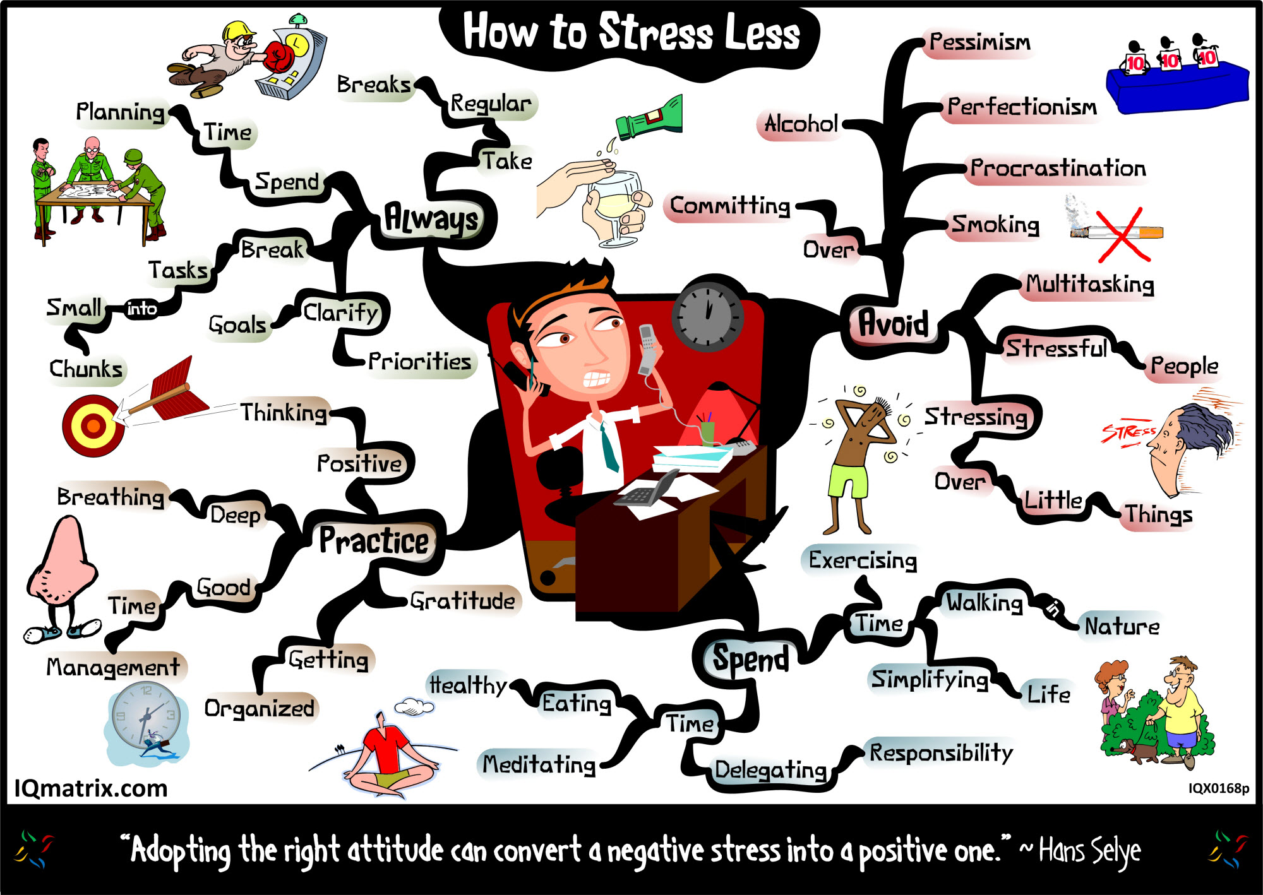
Notes:
Good advice…

Slide 30
10 things to think about

Slide 31
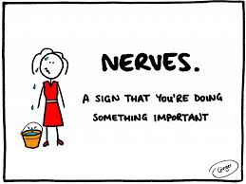
Nerves can be helpful
Notes:
The build-up to an examination is a stressful time and stress can be both productive and destructive. You have to ensure that you can recognise, control and use it to your advantage.
Think about this from before…

Slide 32
Typical feelings
Notes:
Easier said than done for some people, but all of us have suffered from the destructive elements of stress at some stage! It can show itself in some of the following ways.
Tiredness, irritability, feeling unwell or ill at ease
Loss of appetite, unable to sleep
A constant sense of anxiety and worry
Panic attacks, headaches
Inability to focus, concentrate on or complete tasks
Inertia and sense of paralysis; unable to do what needs to be done, putting things off, avoiding problems
Self-doubt, negative thoughts, giving up
Identifying the emotion can help you deal with it.

Slide 33
Planning helps avoid stress
Notes:
Are aware of your strengths and weaknesses –
Plan your time and revision to build in these. Do not avoid the things you find hard – build them in with subjects you find easier or enjoy more.
See in long term plan that you can fit everything in
Be realistic in both ways – i.e. think about how much time you should spend in an evening. Allow time to have fun; relax as well as work BUT do not get caught up with saying you are too busy!!

Slide 34
Don’t judge yourself by others
Notes:
Don’t judge yourself by other people saying what they have or haven’t done, focus on what you are doing and what you know (especially the morning of the exam)
Talking to people can be helpful when you are revising but covering topics 5 minutes before the exam starts in UNHELPFUL

Slide 35
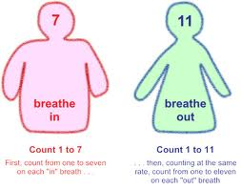
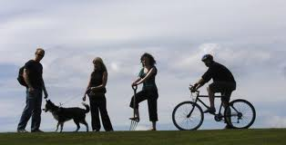
Practise breathing techniques, EXERCISE, get some air
https://www.youtube.com/watch?v=qgIOEMH6oI4
Notes:
Practice breathing and relaxation techniques, take some physical exercise; do something different but strongly focused to take your mind temporarily off revision and examinations

Slide 37
Before you go to bed, wind down
Notes:
leave some time and diversion to wind down at the end of the day before you go to bed, so that you are not trying to go to sleep with unanswered thoughts buzzing around in your head.
It can help to have a note pad beside the bed – is there anything you have to do tomorrow – write it down so you do not forget it.
No phones, social media, films to late in the night

Slide 38
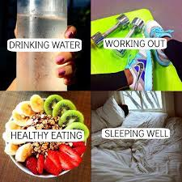
Sleep, eating and drinking – keep a healthy routine
Notes:
live a regular and moderate routine; eat, drink and sleep normally and with a healthy routine (YES 8 hours a night is what you should have!), get some exercise, avoid caffeine and sugar and other “energy” supplements

Slide 39
Track your progress, to recognise achievements
Notes:
make lists to tick off so that you can identify your progress
Congratulate yourself for what you have achieved

Slide 40
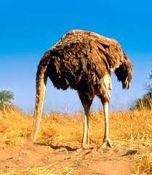
No ostriches
Notes:
Seek help and use support
Don’t bury your head in the sand

Slide 41
Keep it in perspective

Slide 42
What are your 5 a day for a healthy mind?
Notes:
5 things you do/remember that make you feel good…

Slide 43
These things help me have a healthy mind :
1.
2.
3.
4.
5.

Slide 44
Managing my time: planning ahead

Slide 45
Clear the Decks!
There is still lots to do before the exams which isn’t revision.
It is important to be aware of what this all is and when it will be done by.
DON’T LET IT BUILD UP
Notes:
Complete task on p.4

Slide 46
How to plan my time
A short term plan (daily)
A medium term plan (weekly)
A long term plan (monthly)

Slide 47
What am I planning for?
For most subjects there will be more than one exam.
When is each exam and what is on it, is vital information.
Make a list of what is each exam worth and what can come up! (Focus your revision)
Notes:
Look at p.5 & 6 wont be able to fill it all in but can list subjects and then know what to find out.

Slide 48
Daily plans
Not all time is ‘quality’ or ‘high energy’.
Don’t forget to plan breaks for relaxation. If you usually go to football/aerobics etc… then still go!.
At the end of the day’s revision adjust the revision plan if you need to.
Notes:
Think about different times for harder tasks (e.g. in the morning). Lower level maintenance tasks can be done when energy levels are low (e.g. straight after school, before meal times or late at night).
As long as you have planned effectively, this is still possible
If you haven’t managed to get through what you’ve planned or you have got further than expected, this can have an affect on the medium and longer term plans of your revision.

Slide 49
Weekly plans
These are designed to give you a bit more of an overview and will help you avoid missing out on subjects or spending too long on one thing.
Allow a time slot to set out the following week’s plan.

Slide 50
Long-term plans
Long term revision plans need to accommodate many other demands made on you and will change.
Be realistic: the time you set aside needs to be productive, effective and work!
Whilst at school, take advantage of all the revision sessions and tasks put on by teachers in different subjects.
Use their expertise to clarify/reiterate any topic that you don’t quite get.
Notes:
Coursework/homework is still happening
School goes on
Some of you have part-time jobs Long term revision plans need to recognise all of these
In order to discover what they are, look over your subject materials in the next few weeks before it’s too late.

Slide 53
Don’t panic
There is still plenty of time, if you use the time wisely!
11 weeks (9 in school)
77 days (45 in school)
Around 620 hours (8 per day)
Notes:
This is until May 8th but time does not stop then, you still have plenty of time then!

Slide 54
Notes:
We all learn and work in different ways. Some of us plan in detail in advance, some of us work better under pressure.
Some us of will like lists and bullet points in our notes, others will like pictures and diagrams
If we had a list of ten words to remember on the board, there would be a different one each of us would forget.

Slide 55
Revision Strategies
How can you help yourself

